Slide 1

Is it a force?
A force is a push or a pull.
It is sometimes difficult to spot when there is a force.
For each picture decide: force or no force

Slide 2
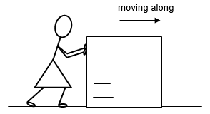
Is it a force?
1. Karen is pushing a large box across the floor.
It is moving steadily.
force or no force

Slide 3
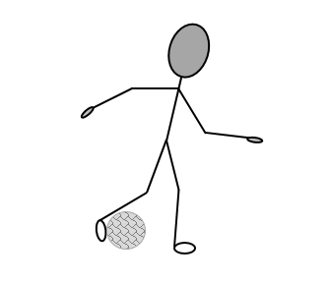
Is it a force?
2. During a game of football, Shane kicks the ball.
force or no force

Slide 4
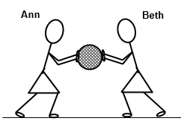
Is it a force?
3. During a game of netball,
Ann and Beth are both pushing on the ball.
It is not moving.
force or no force

Slide 5
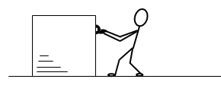
Is it a force?
4. A workman is trying to pull a heavy box across the floor.
It is not moving.
force or no force

Slide 6
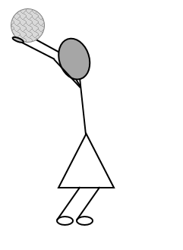
Is it a force?
5. During a game of football, Alice takes a throw in.
force or no force

Slide 7
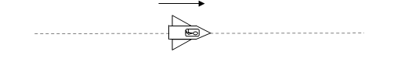
Is it a force?
6. A spacecraft is drifting through space.
It is very far from all other objects.
There is no air in space, so there is no air resistance.
The spacecraft is moving in a straight line at a constant speed.
force or no force

Slide 8
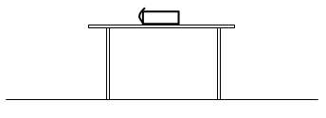
Is it a force?
7. A heavy book is sitting on a table.
force or no force

